Slide 1
Quality and Cost
in the
True Performance Program
Capstone Project 2019 – Highmark Inc
Moe Wolf (MSHCPM ‘20)
Jonathan Dyer (MISM ‘19)
Jeremiah Humes (MSHCA ‘20)
Manjiri Kshirsagar (MSHCPM ‘20)
Faculty Advisor: Jim Jordan

Slide 2
Agenda
Problem Statement
Framework for Evaluation
Analysis
Recommendations

Slide 3



Objective
Which of the quality metrics are driving the cost outcomes?
What other quality metrics could potentially be added?
Investigate other value-based reimbursement programs.

Slide 4

Program Evaluation Framework
What is it?
Scientific method to study social interventions [1]
Evaluates program effectiveness and efficiency
Systematic approach to improve or affirm success of a program
Why did we choose it?
Eliminate the issue of confirmation bias
Investigate areas where a program can be improved
Explore reasons for certain features not working
Industry standard method for assessment

Slide 5
Program Evaluation Framework
Needs Assessment
Program Theory
Process Evaluation
Outcome Evaluation
Nature, magnitude and extent of the problem
Program conceptualization and design
Program operations, implementation, service delivery
Impact on targeted outcomes

Slide 6
Constraints and Limitations
Lack of comprehensive time series data
Time duration of evaluation
Provider level data for those who did not participate in program
Lack of control data
Limited access to participating providers

Slide 7
Determining the Nature of the Problem
Needs Assessment
Program Theory
Process Evaluation
Outcome Evaluation
What is the problem that the program is trying to address?
What is the extent of the problem?
Who is the target population?

Slide 8
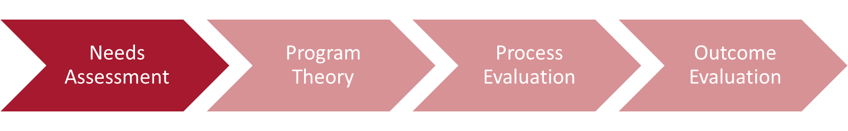
Needs Assessment (Manjiri)
Problems addressed through this program
Overutilization of services due to the fee-for-service model
Misaligned incentives
Poor quality outcomes
Extent of Problem
<Add stats>
Target Population
Providers (Primary Care Physicians)
Patients

Slide 9
Needs Assessment
Problems addressed through this program
Overutilization of services due to the fee-for-service model
Misaligned incentives
Poor quality outcomes
Extent of Problem
<Add stats>
Target Population
Providers (Primary Care Physicians)
Patients

Slide 10
Defining the Blueprint of the Program (change bullestststst)
Needs Assessment
Program Theory
Process Evaluation
Outcome Evaluation
Understanding the program and its components
Intended Effect of Program
Environmental scan
Notes:
Explain the difference between implementation and theory, that there could be a breakdown in logic at either point blah blah blah

Slide 11
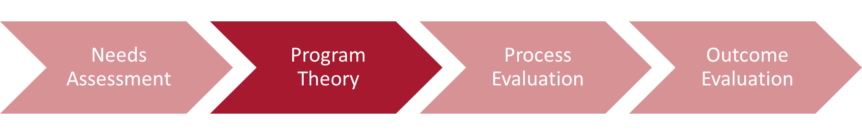

True Performance Objectives
Supporting Primary Care Physicians (PCPs) in coordinating care, managing chronic illness, and providing preventive care.
Improve Experience of Care
Improving Health of Population
Reducing Per Capita Cost of Healthcare
Based on IHI’s (Institute of Healthcare Improvement)
“Triple Aim” of healthcare improvement

Slide 12
Program Hierarchy
Reimbursement Opportunities
Reimbursement Type
Care Coordination
Lump Sum
Additional Incentives
Performance Measurement
Quality
Referral Management
Strong Medicare STARS ratings
Quality
Cost & Utilization
Indicators
Total Cost PMPM
ED Utilization
STARS Ratings
QA Score

Slide 13
Program Hierarchy
Reimbursement Opportunities
Reimbursement Type
Care Coordination
Lump Sum
Additional Incentives
Performance Measurement
Quality
Referral Management
Strong Medicare STARS ratings
Quality
Cost & Utilization
Indicators
Total Cost PMPM
ED Utilization
STARS Ratings
QA Score

Slide 14
Stakeholder Perspective
Regulatory
Highmark Insurance
Primary Care Physicians
Patients
Aligns with Medicare Plan
STARS Ratings
Reduce increase healthcare costs
Incentivized to focus on prevention and wellness
Better health outcomes especially for chronic illness patients
Reduce preventable Emergency Department visits
Allows PCPs to improve their processes and implement best practices
Incentives aligned for payers and providers to improve patient experience
Reduce readmissions and inpatient stays

Slide 15
Quality Component Logic Model (Manjiri)

Slide 16
Environmental Scan

Slide 17
Program Implementation (bullttltltrstststsets)
Needs Assessment
Program Theory
Process Evaluation
Outcome Evaluation
Recipient Perspective of Program
Implementation Fidelity – Dose Delivered and Received

Slide 18
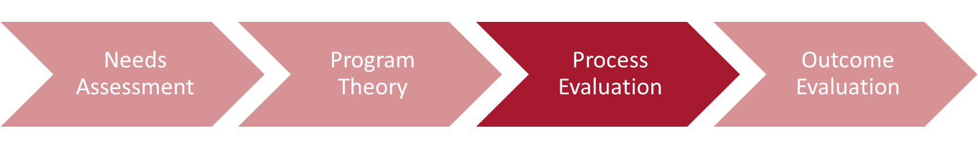
Process Evaluation
Are participants satisfied with the program? (Satisfaction)
“An unreasonable number of reasonable requirements”
How many providers/ persons are part of the program? (reach)
Providers in program: 548
Patients in program: 1.16 million
Extent to which participants actively engage with program (dose received)
Perhaps too frequently in too cumbersome of a manner
“Had to employ an army of administrators to make this work”
Amount of each component delivered/ details about quality metrics? (dose delivered)
Some metrics seem to express co-linearity,
There are some “buckets” that don’t seem to have any metrics - outcome measures, health measures

Slide 19
Process Evaluation
Are participants satisfied with the program? (Satisfaction)
“An unreasonable number of reasonable requirements”
How many providers/ persons are part of the program? (reach)
Providers in program: 548
Patients in program: 1.16 million
Extent to which the program was implemented consistently with underlying theory/ design/ philosophy. (fidelity of program)
source
improve healthcare quality outcomes for members - no data
reduce annual increases in total health care costs - only have data on 1 aggregated line/can we get more precise numbers?
help physicians engage in patient care coordination - unsure how TPP would improve this
help physicians engage in population health management - no data on health of population
Extent to which participants actively engage with program (dose received)
Perhaps too frequently in too cumbersome of a manner
“Had to employ an army of administrators to make this work”
Amount of each component delivered/ details about quality metrics? (dose delivered)
Some metrics seem to express co-linearity,
There are some “buckets” that don’t seem to have any metrics - outcome measures, health measures

Slide 20
Process Evaluation
Satisfaction
“An unreasonable number of reasonable requirements”
each
Providers in program: 548
Patients in program: 1.16 million
dose received
Perhaps too frequently in too cumbersome of a manner
“Had to employ an army of administrators to make this work”
dose delivered
Some metrics seem to express co-linearity,
There are some “buckets” that don’t seem to have any metrics - outcome measures, health measures

Slide 21
Program Impact on Outcomes
Needs Assessment
Program Theory
Process Evaluation
Outcome Evaluation
Did the program have the intended impact on the correct population?
What were the key metrics that caused the observed effect?

Slide 22
Process Evaluation
Key performance indicators
PMPM cost
Define the counterfactual (outcomes in the absence of the program)
The counterfactual is what would have happened to the patients, the doctors, the cost and quality of care of those affected by the TPP had all else remained the same except the program not been implemented.
Cannot compare with counterfactual results—no data for non-TP providers
Additionally, no pre-/post- comparisons are possible—no data prior to 2018
One way to do this would be to randomize who gets to take part in TPP from those who opt in
What could be the potential confounders/ selection bias?
Opt-in
Implementation of other programs at the same time
Program effects (regression analysis results)
Difference in outcomes between regions
Which measures contribute most to the cost outcome?
Jake?

Slide 23
Dataset overview
Flowchart
Distribution/descriptive stats
Correlation matrix
Multiple regression
PCA
Stepwise
Lasso
General results summary

Slide 24
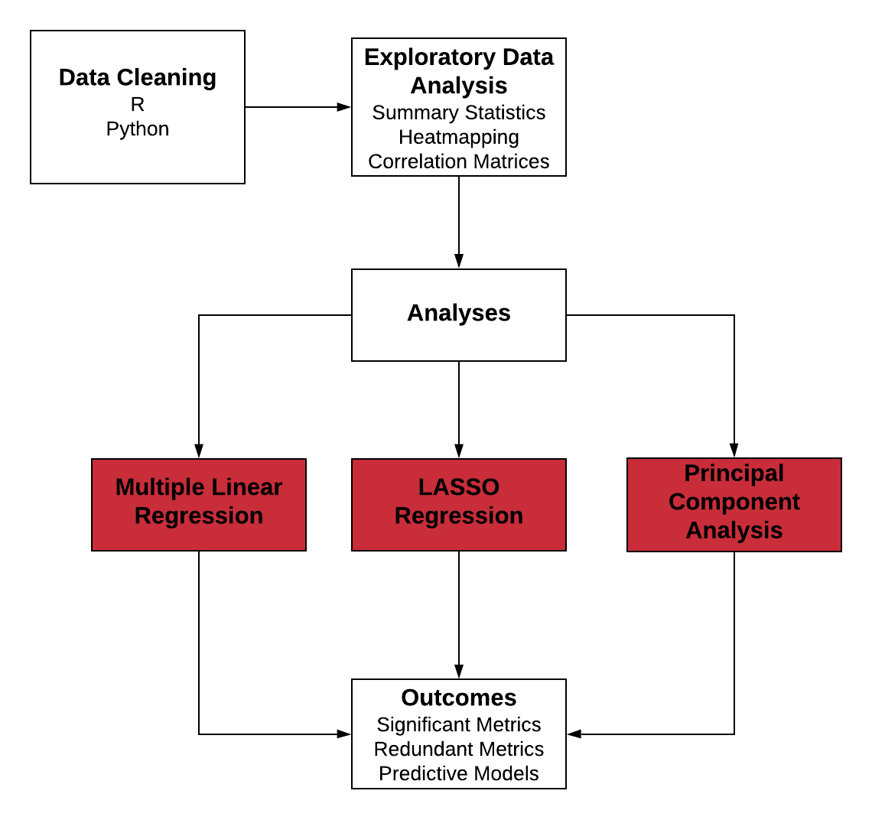
Quantitative Methods

Slide 25
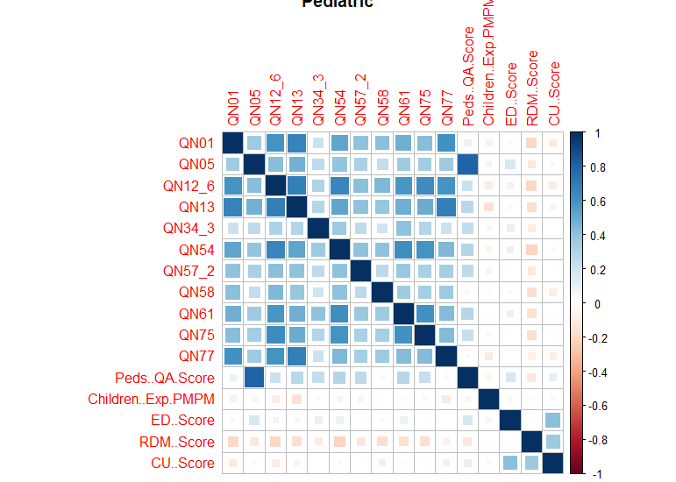
Correlation Matrices (Pediatric shown)

Slide 26
Key Insights
Most metrics had a relatively high degree of correlation
Outcomes showed no strong correlation with metrics or with each other
Except RDM and CU score, these had high positive correlation
Need to choose methods that deal with collinearity well.
Too many metrics and outcome combinations to choose an effective subset manually

Slide 27
Forward Stepwise Selection
Further Refinement of Regression Models (Adult Population Shown, selected with BIC criteria)
QA | PMPM | ED | RDM | CU
QN02.4 | QN08 | QN02.3 | QN41 | QN35
QN09 | QN41 | QN02.4 | QN45 | QN44
QN35 | QN46 | QN78 |  | QN45
QN44 | QN60 |  |  | QN77
QN55 | QN78
QN64
QN69
QN77
QN78

Slide 28
Key Insights
Adult Pop.: Selection usually cut 2-3 significant variables
7 cut from ED score
Senior Pop.: Usually cut between 0-2
Tended to have a lower number of significant metrics
Pediatric Pop.: Same as seniors

Slide 29
LASSO Regression
PMPM | QA | ED | RDM
QN08 | QN02.3 | QN78 | QN41
QN09 | QN02.4 |  | QN45
QN40 | QN35
QN41 | QN41
QN78 | QN44
 | QN9
 | QN55
 | QN64
 | QN69
 | QN71.2
 | QN78

Slide 30
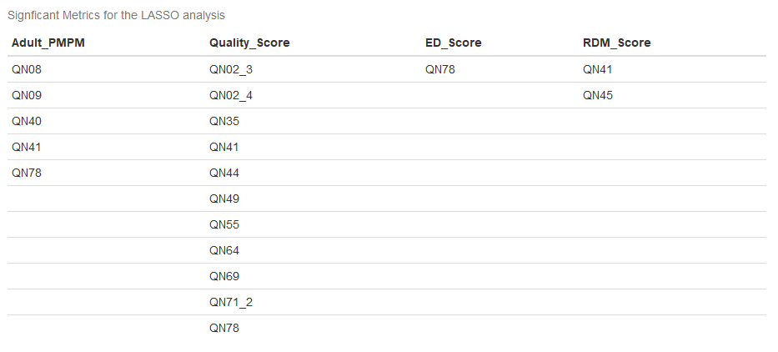
LASSO Regression (other chart if this looks better)

Slide 31
Key Insights
Represents our best approximation of significant metrics
Generally agreed with our other regressions
ED only had 1 significant metric
Pediatric PMPM had none
In general, ED, RDM, and CU always had less metric associated compared to PMPM

Slide 32
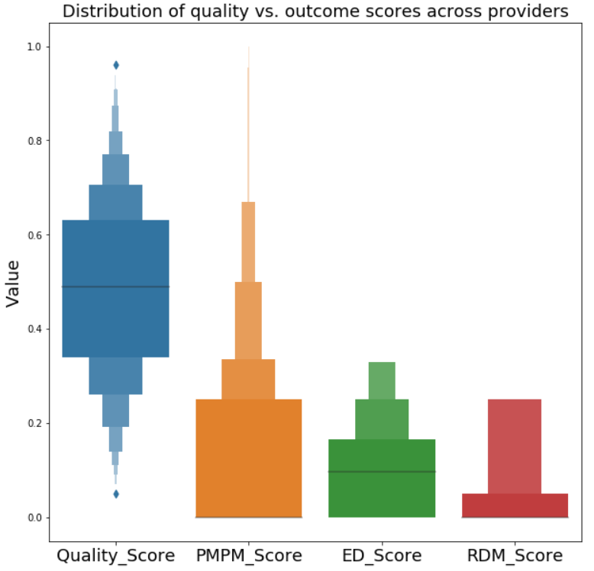
Quality and Outcomes

Slide 33
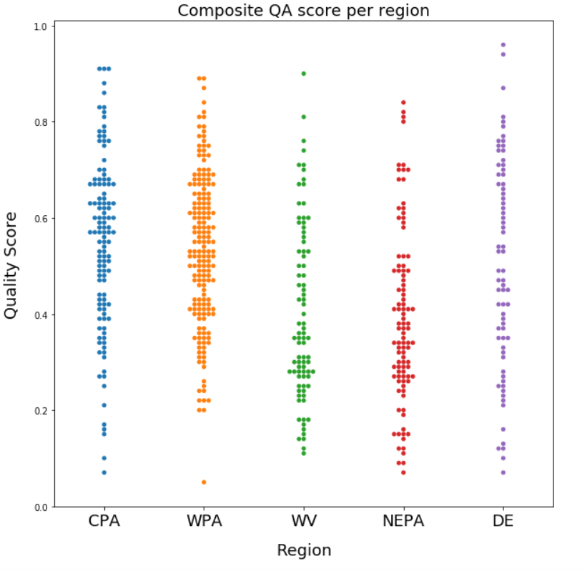
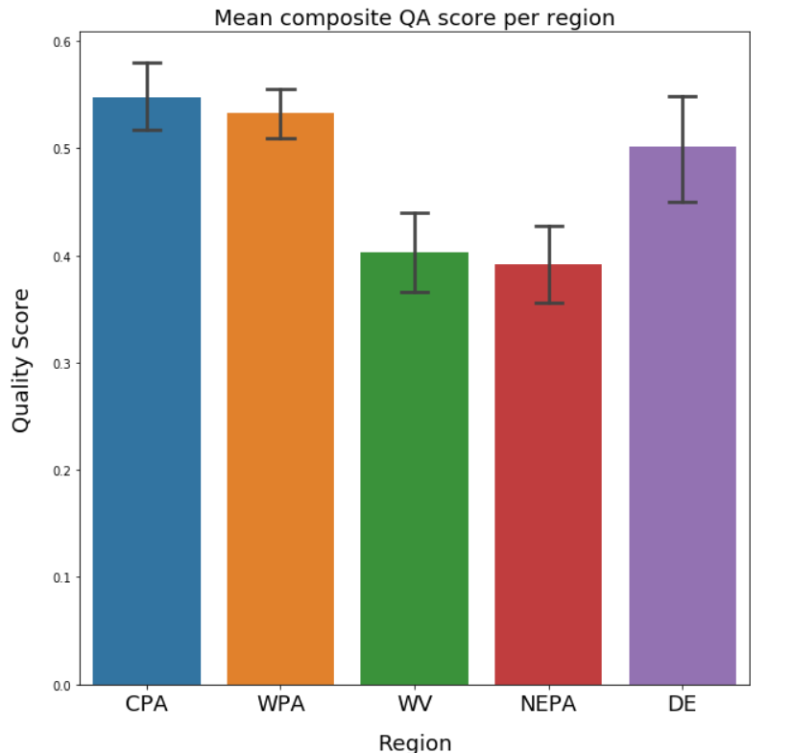
QA Score per Region

Slide 34
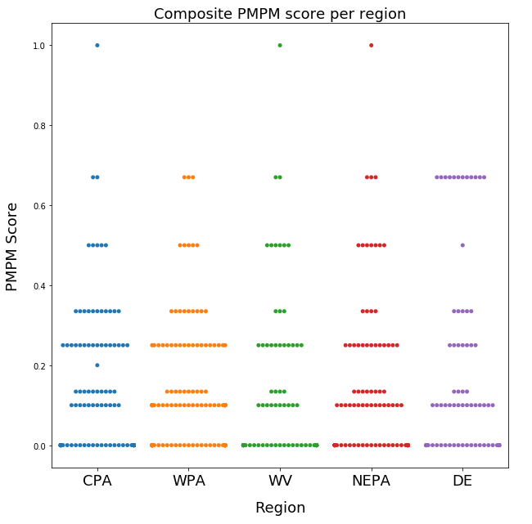
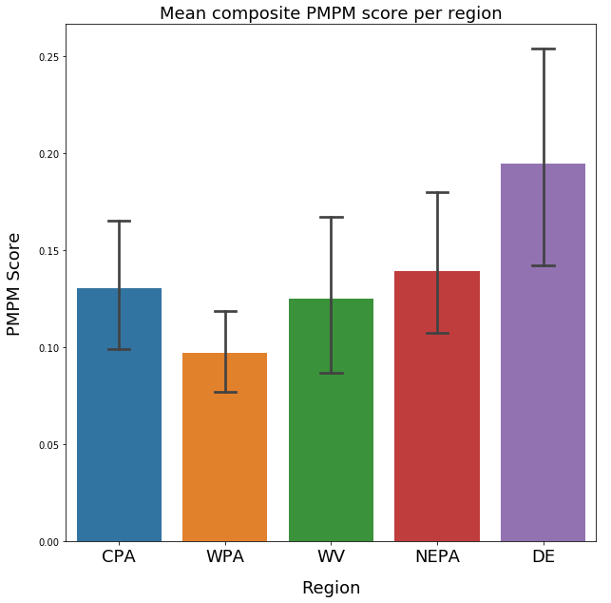
PMPM Score per Region

Slide 35
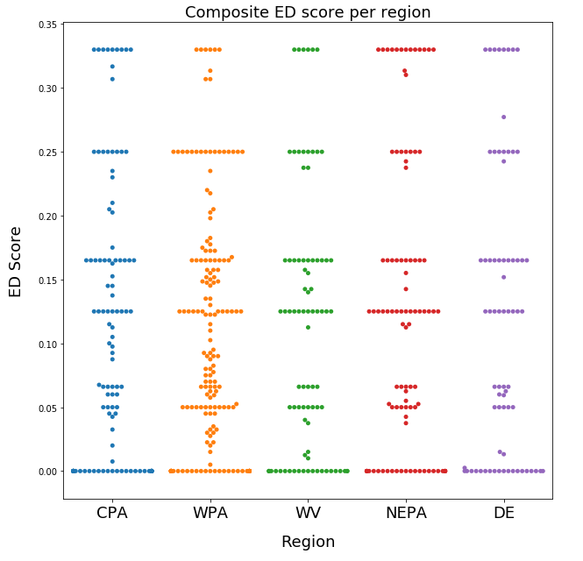
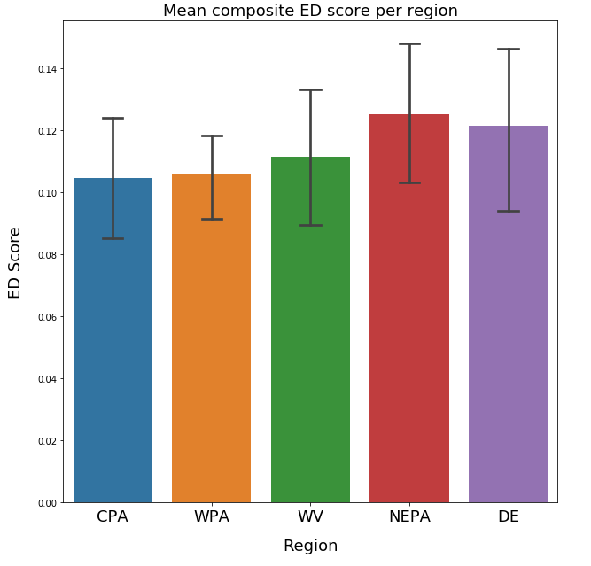
ED Score per Region

Slide 36
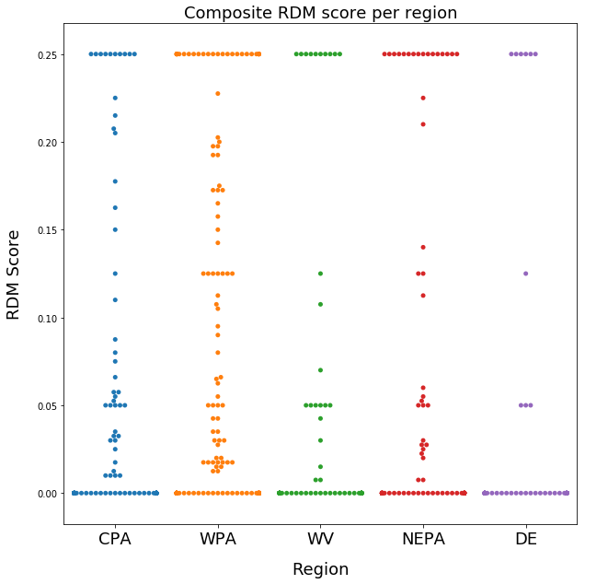
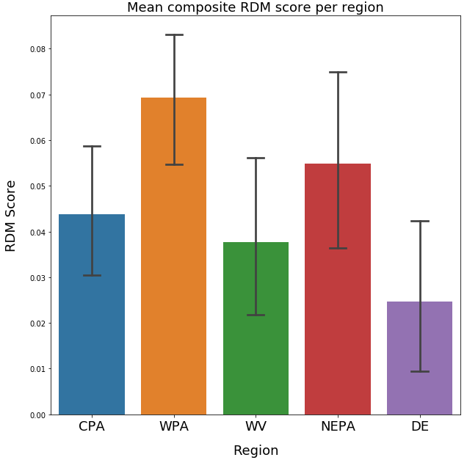
RDM Score per Region

Slide 37
Program Effects

Slide 38
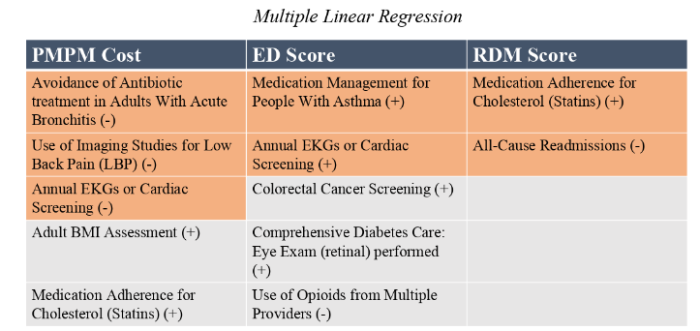

Multiple Linear Regression

Slide 39
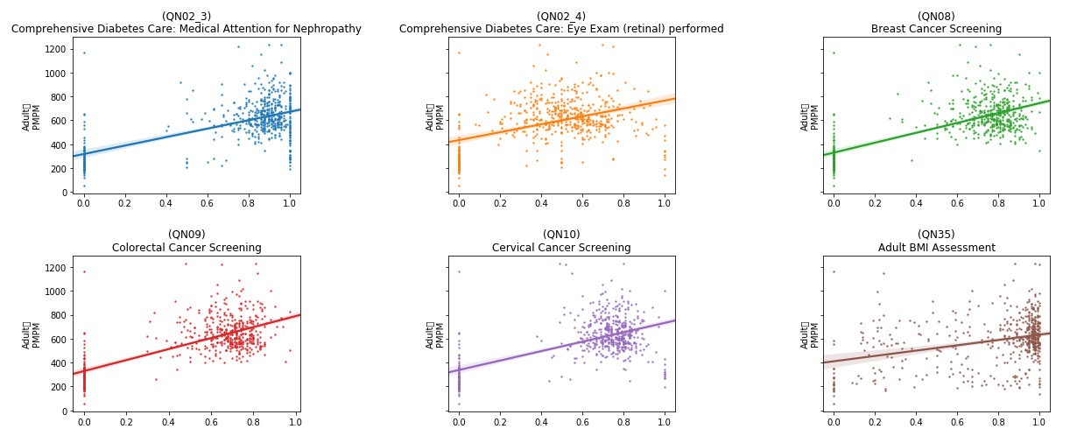
Rates vs. Adult PMPM
Adult
PMPM
Adult
PMPM
Adult
PMPM
Adult
PMPM
Adult
PMPM
Adult
PMPM
Rate
Rate
Rate

Slide 40
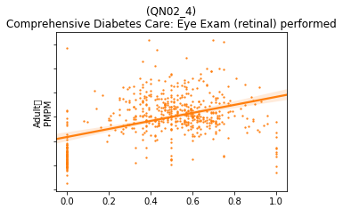
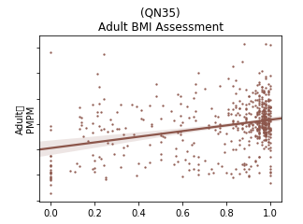
Rates vs. Adult PMPM, zoomed in
Adult
PMPM
Adult
PMPM
High variability
Low confidence

Slide 41
Findings
The analysis for the Adult population shows mixed results.
Several variables showed a high statistical correlation with the three outcomes. Some of these were expected, while a number were inversely correlated or unexplained.
Ultimately the high variance in the data and the low confidence values indicate that more collection and study should be done.
Detailed results are given in the appendix.

Slide 42
Findings v2
The analysis for the Adult population shows mixed results.
Several variables showed a high statistical correlation with the three outcomes. Some of these were expected, while a number were inversely correlated or unexplained.
Ultimately the high variance in the data and the low confidence values indicate that more collection and study should be done.
Detailed results are given in the appendix.

Slide 43
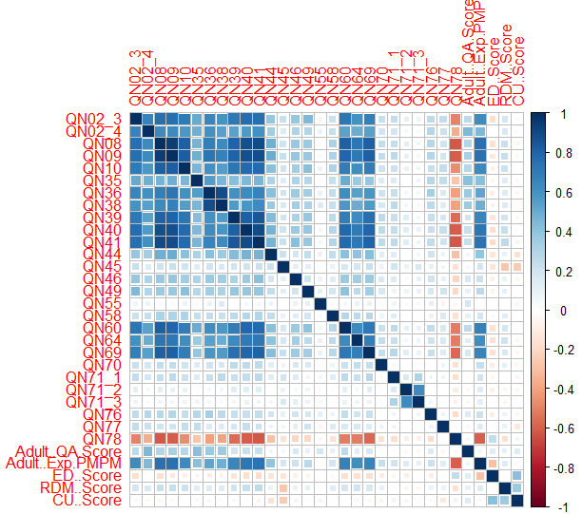
Collinearities in the data
Several variables were found to be correlated with each other
This could lead to skewed results in a standard regression test
Lasso regression and PCA can account for this problem

Slide 44
Recommendations

Slide 45
Questions?

Slide 46
Appendix

Slide 47
Program Eval in detail

